Slide 1
Dynamics Project
Gyroscope
Group 1:
Chaitali Karekar Uday
ME20B053
Sneha M S
ME20B052
Vidhyasri B
ME20B050

Slide 2
Objectives
To visually understand the principles of working of Gyroscope (rigidity and precession)
To visually understand Gyroscopic couple
Applications:
Gyroscopic Compass
Gyroscope in an altimeter and turn indicator – application of rigidity and precession

Slide 3
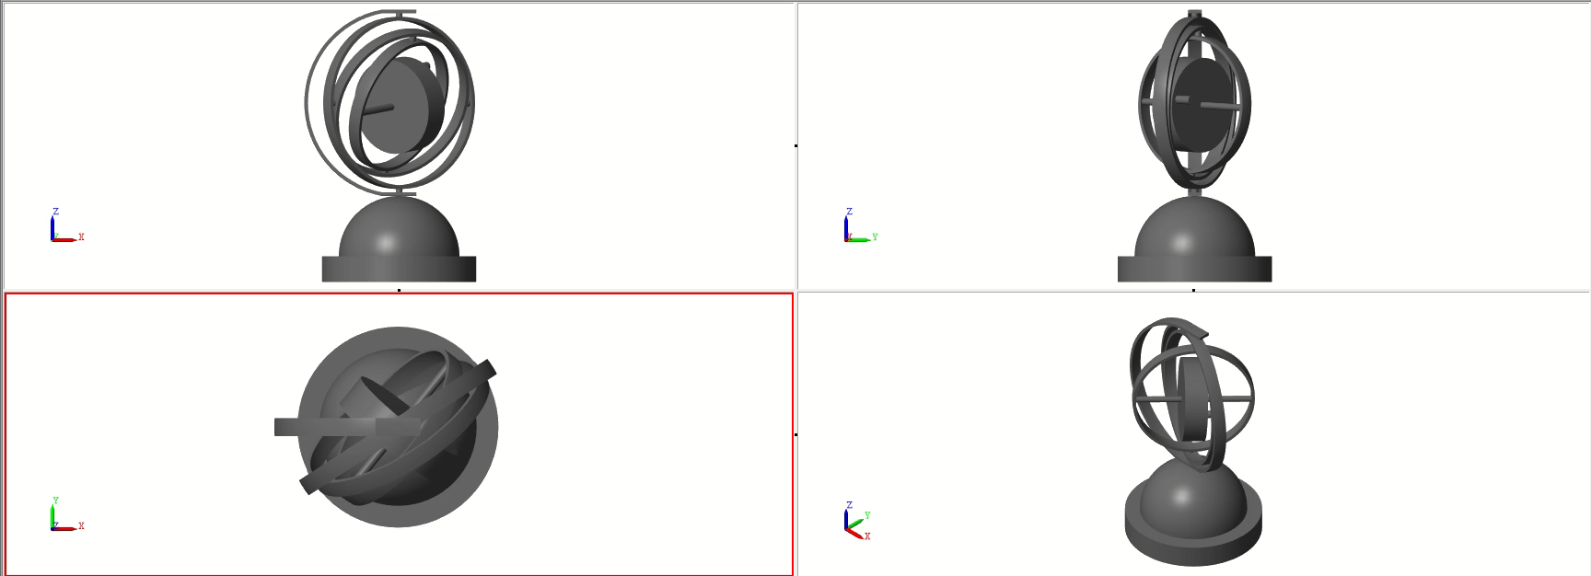
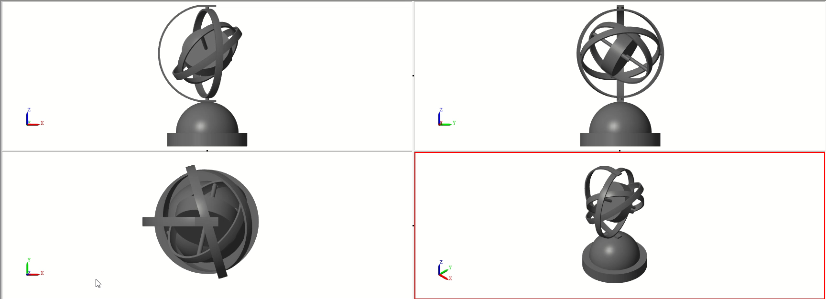
Rigidity and Precession
Rigidity in space describes the principle that a gyroscope remains in the fixed position on the plane in which it is spinning, unaffected by the Earth's rotation.
Tilting or turning of a gyro in response to a force is called Precession

Slide 4
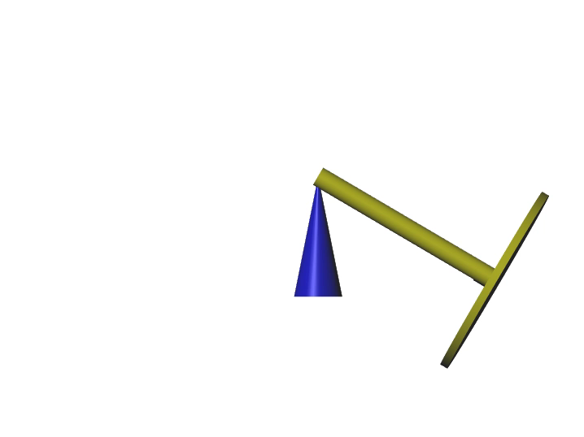
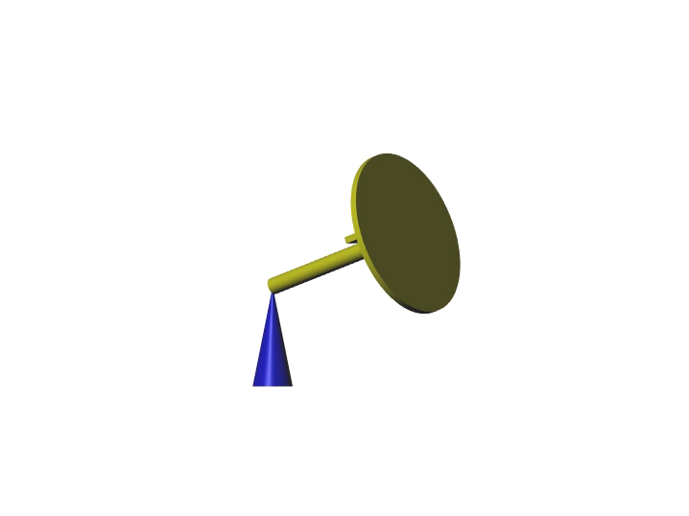
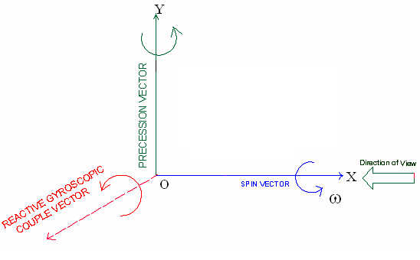

Gyroscopic couple

Slide 5
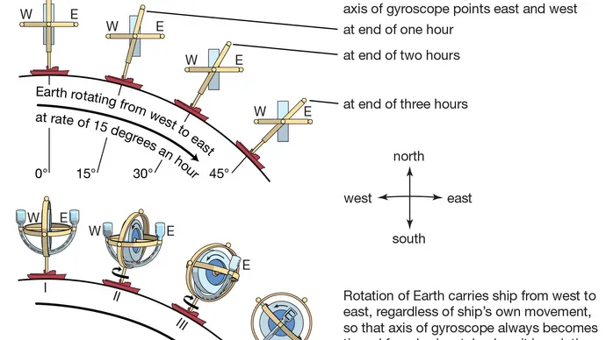
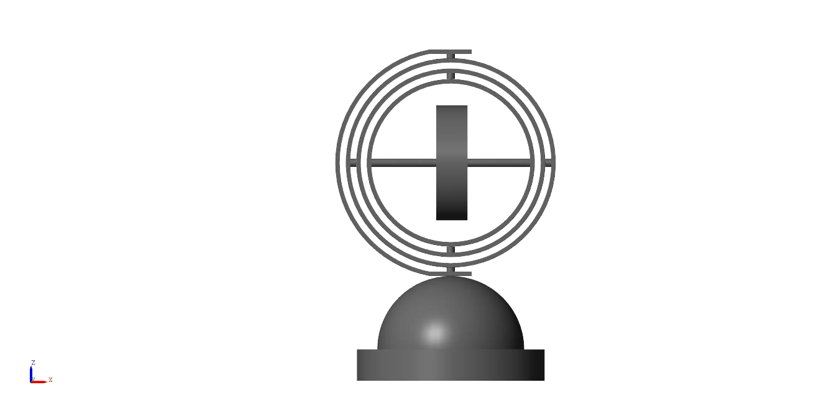
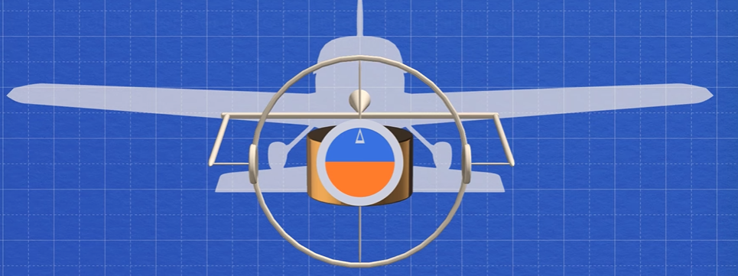
GYROCOMPASS and Altimeter
A gyrocompass seeks north. It detects the rotation of the Earth about its axis and seeks the true north, rather than the magnetic north.

Slide 6
THANK YOU!!!

